Slide 1


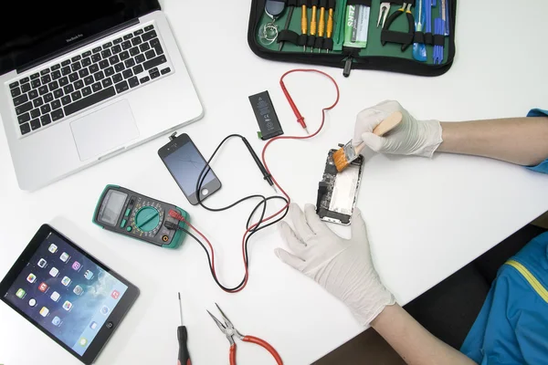
ERepairo Everything At Your Fingertips!
A PROJECT P R E S E N T A T I O N

Slide 2
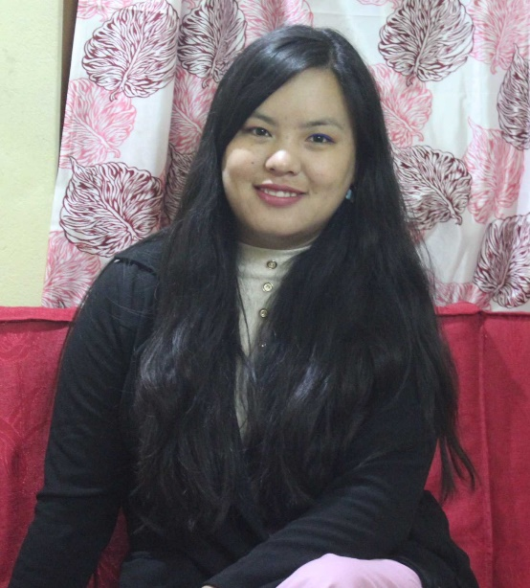
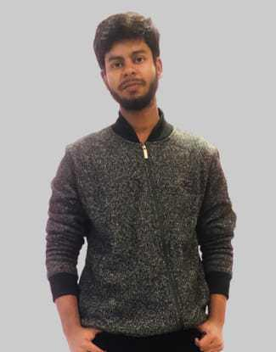
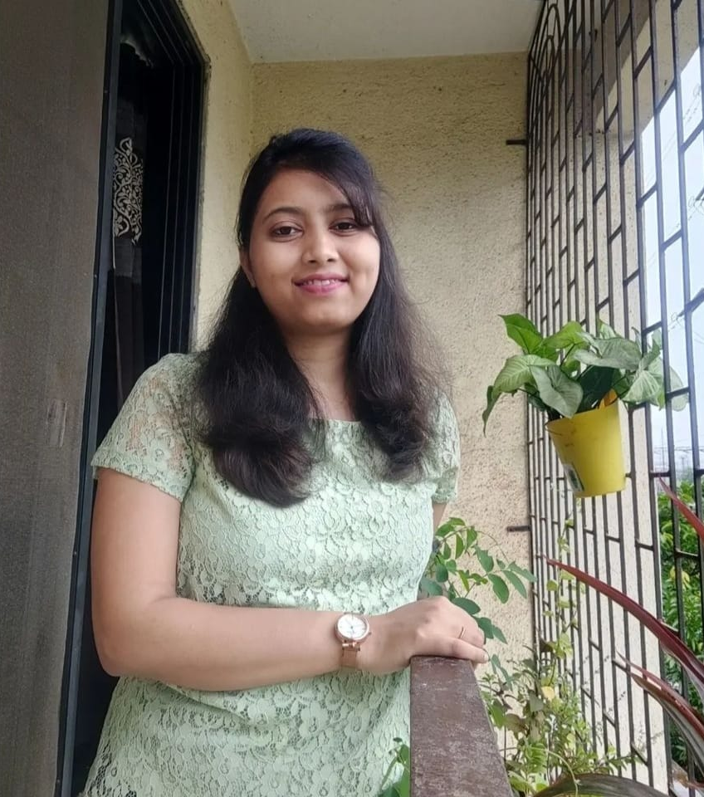



MEET OUR TEAM
Sharmila Thapa
Murtaza Najmi
Shivani Pakade
Sushanth M
Aayush Dogra
Mohd Zaid

Slide 3

ERepairo
Nowadays electronic items (like Mobile Phone, etc) have become an important part of our day-to-day life. If they are not working or get damaged, it's hard to manage a day without these items. And when a user visits service centers, they have to wait for getting served.
So, there is a need for an application for users to book slots for repairing or servicing electronic items and also, they can make the payment on the same application.

Slide 4
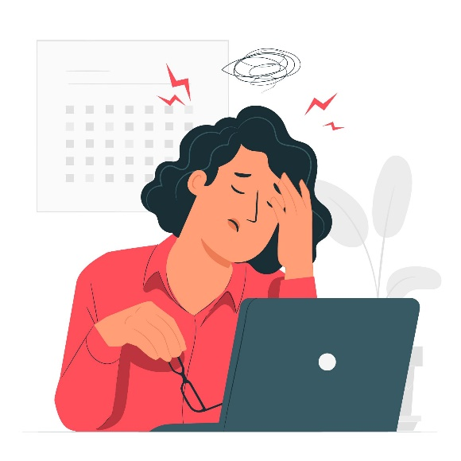
Pain Points
Customers have to wait in long queues at the service centers to get their devices repaired.
Local Service providers confront difficulties in finding customer for their services, and vice versa.
For service providers, too much crowd to handle at once. No proper planning as slot booking system is not available.
Difficulty in keeping track of service, payments, performance, and so forth.
Extra work load resulting in bad customer service and bad company ratings/reviews.
For users in small cities who do not have service centers in their city, it is a problem to visit neighbouring cities. Sometimes they need to visit multiple times or service centers are closed.

Slide 5
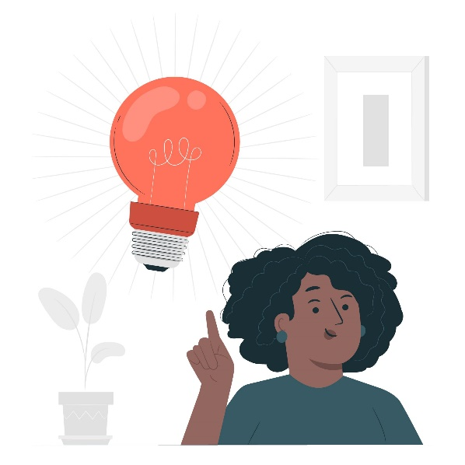
Solutions
Erepario provides a platform for Customers with the convenience of finding service providers on-hand and it provides the opportunity to the local Service Providers to attract the customers and earn a living.
As the pandemic hit, we all know how much the contactless services have became necessary.
With this application user can book an appointment at the service centre for their electronic items to get repaired.
Online booking can help maintain a proper schedule of customer visits .
With our application, we have integrated the payment service so that customers can make payments without any disputes.

Slide 6
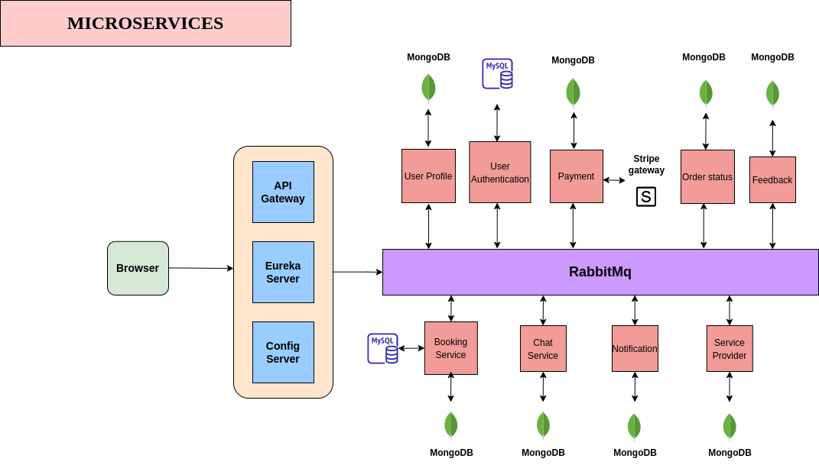
B A S I C
$490

Slide 7
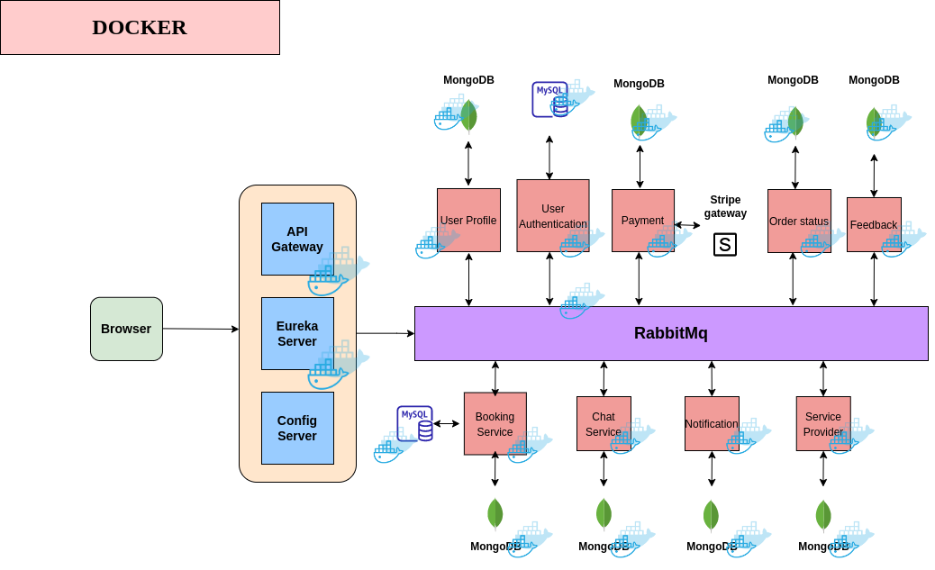
P R E M I U M
$990

Slide 8
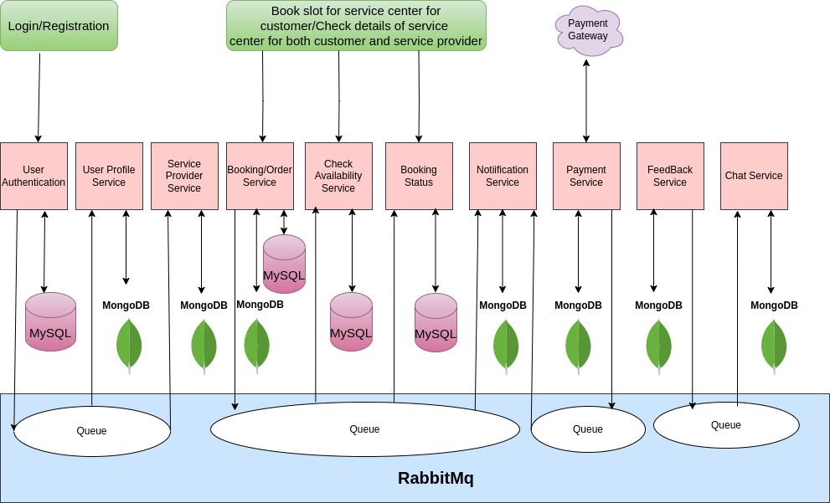
Data Flow
B A S I C
$490

Slide 9
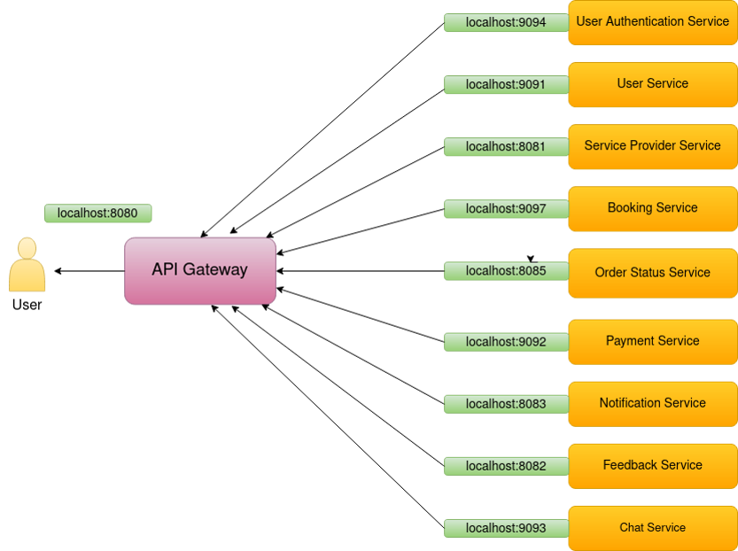
API Gateway

Slide 10
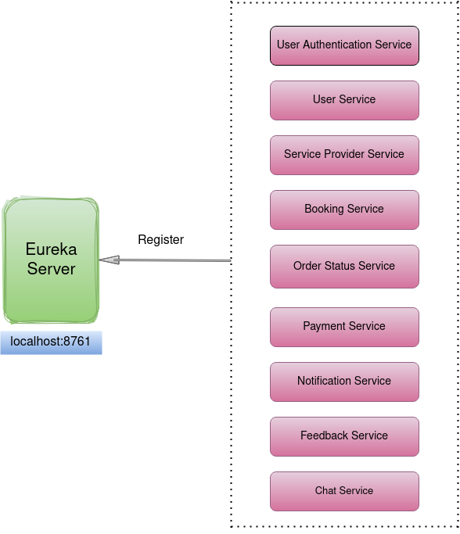
Eureka Server

Slide 11
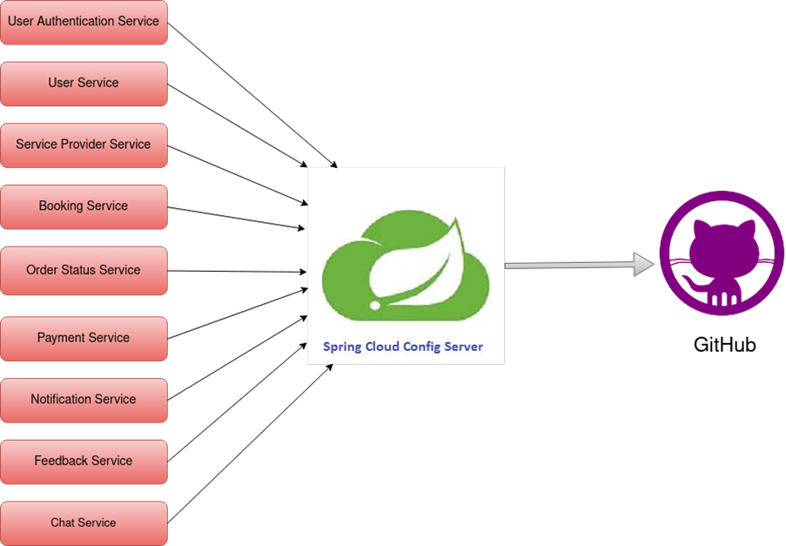
Config Server

Slide 12
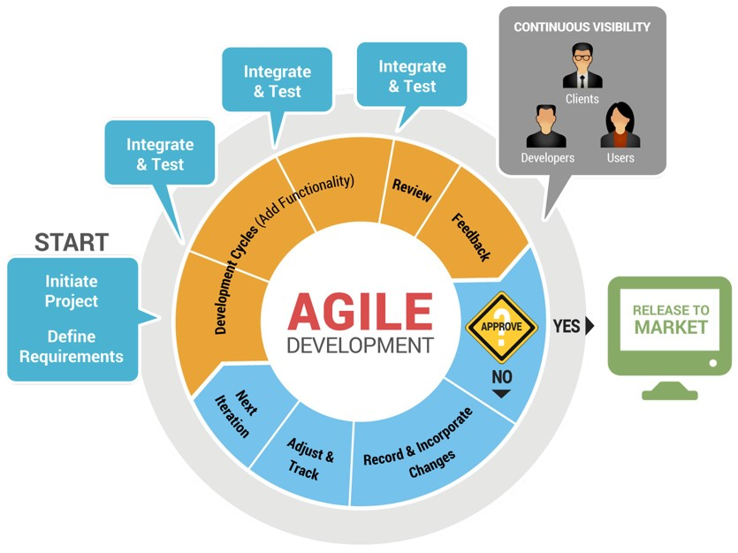
Agile Framework

Slide 13
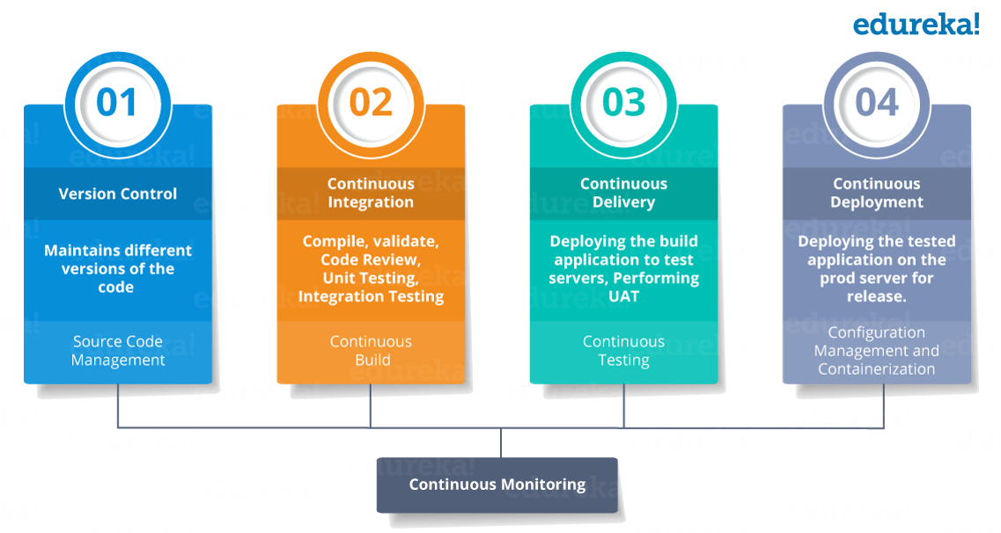
CI/CD

Slide 14
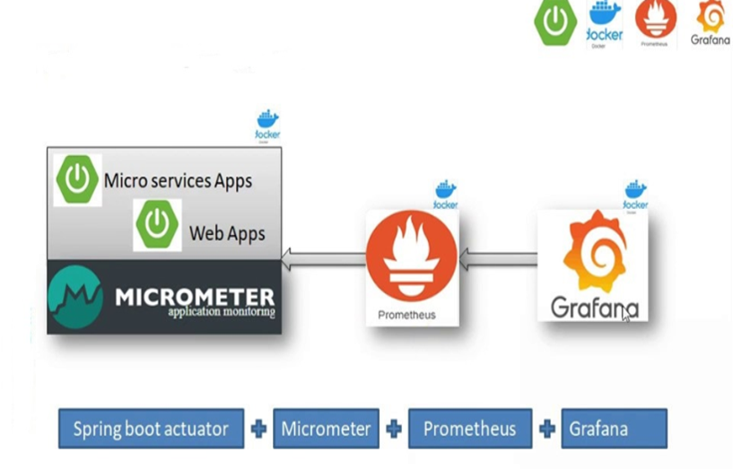
Prometheus & Grafana

Slide 15
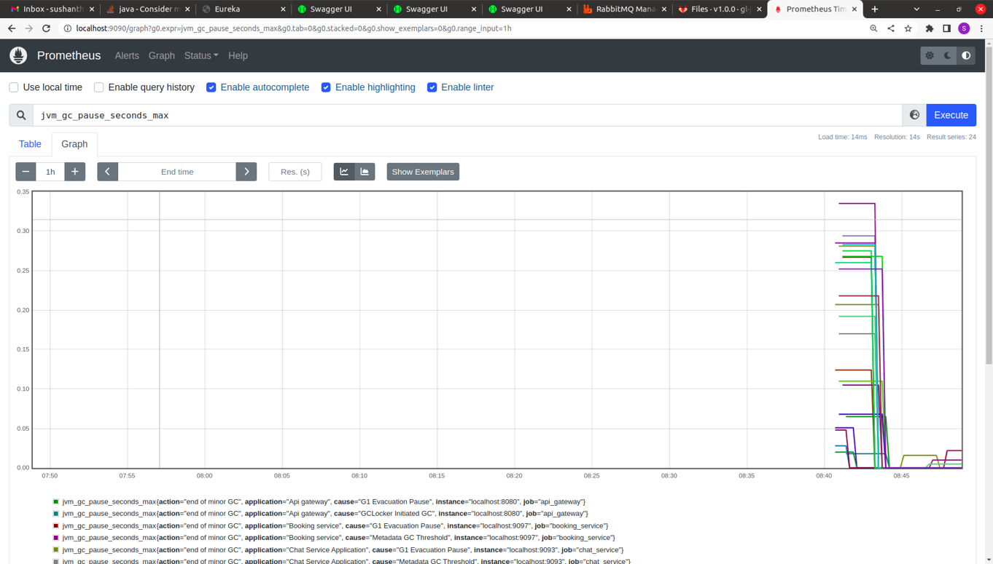

Prometheus

Slide 16
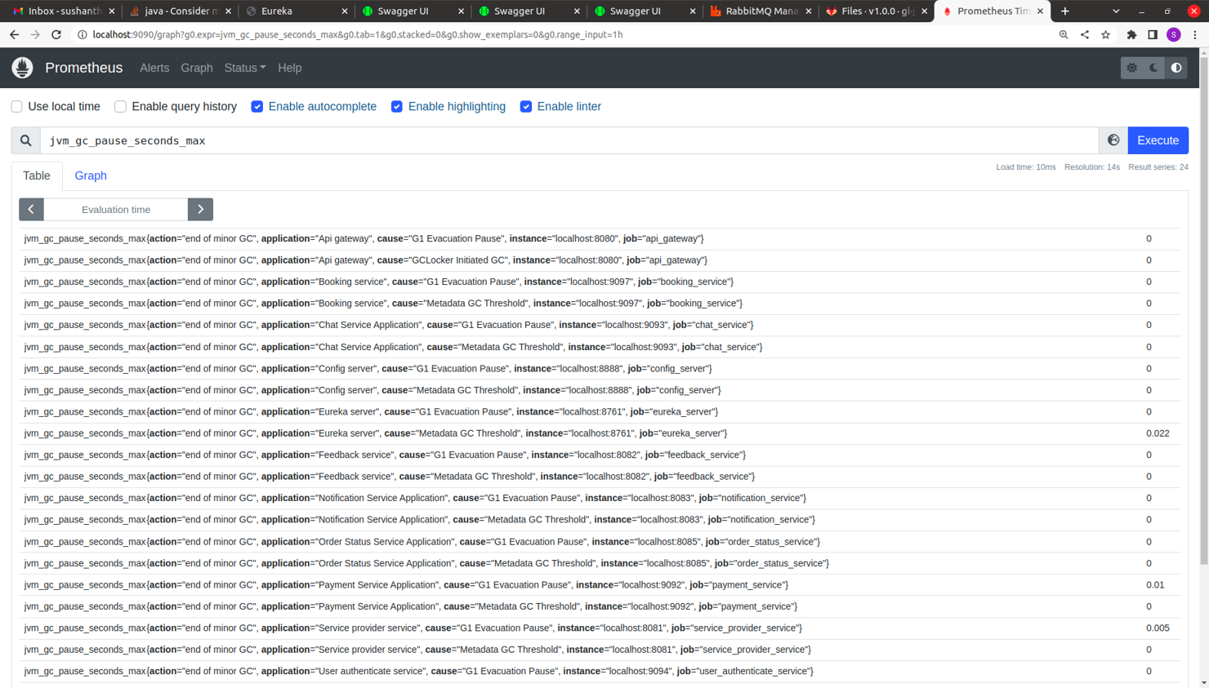

Slide 17

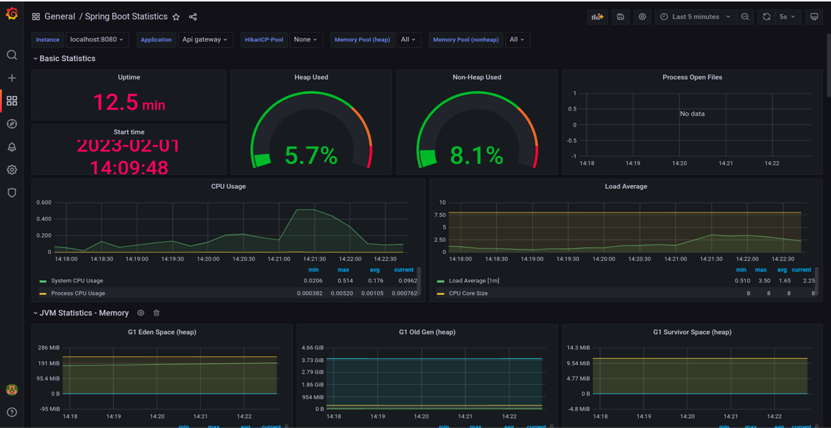
Grafana

Slide 18
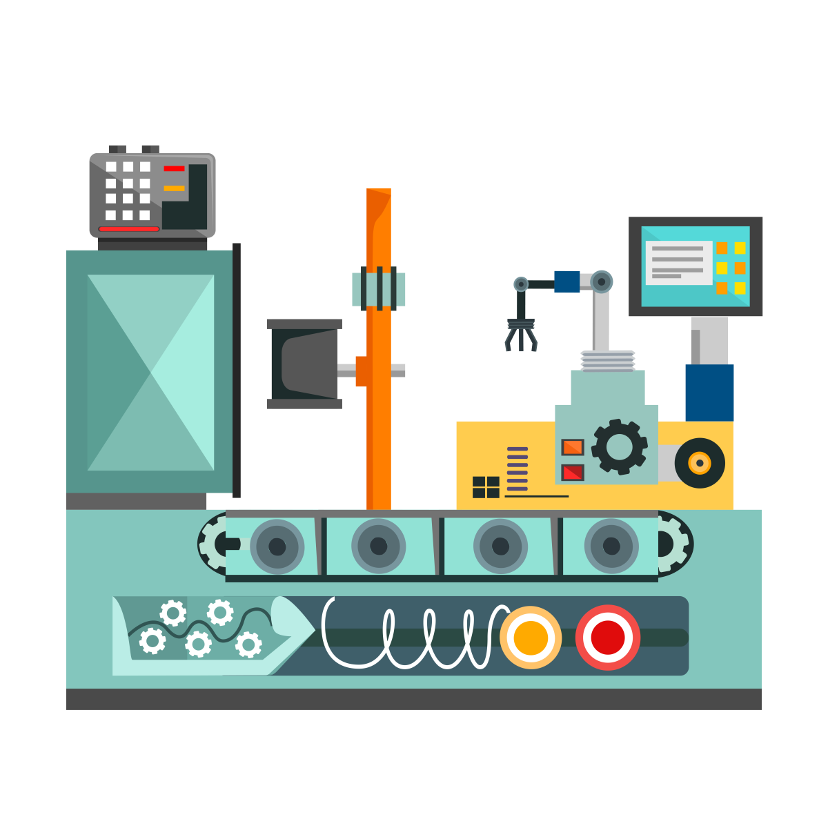
Microservices Demonstration

Slide 19

Product Backlog
Google Authentication
FAQs by Users
Multilingual Support
Accept all payment methods

Slide 20
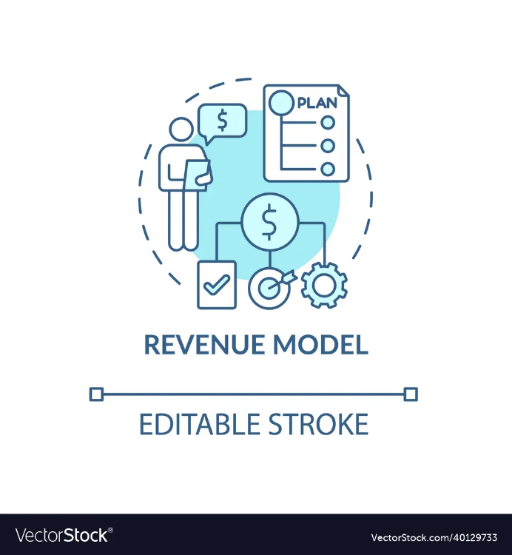
Revenue Model
Revenue could be generated using Google Ad-sense.
Providing Discounts to the premium members.
Subscription plans to avail expert services Monthly/Yearly.

Slide 21











Tech Stack
Development
Database
Presentation
Platform

Slide 22


